Slide 1
Mapping Existing Globals to Objects and SQL
Mike LaRocca
InterSystems Corporation

Slide 2
Agenda
Storage Strategy Overview
CacheStorage
CacheSQLStorage
CustomStorage
CacheSQLStorage Example

Slide 3
Storage Strategy Comparisons
 | CacheStorage | CacheSQLStorage | CustomStorage
SQL |  |  | 
Objects |  |  | 
 Automatically provided by Caché
 Manually provided by database designer

Slide 4
Choosing Your Storage Strategy
CacheStorage is ideal for brand new applications
CacheSQLStorage is typically used where existing global structures can be expressed relationally, and Object access can be code-generated based on SQL statements
CustomStorage is used when existing global structures can or cannot be expressed relationally, and complex logic must be used to provide Object access

Slide 5
Agenda
Storage Strategy Overview
CacheStorage
CacheSQLStorage
CustomStorage
CacheSQLStorage Example

Slide 6
CacheStorage Overview
Application
%LoadData
%SaveData
%DeleteData
Object API
Object Implementation
ObjectScript
ObjectScript
ObjectScript
Globals

Slide 7
CacheStorage Notes
CacheStorage generates list-based global structures
The unique identifier (IDKey / PrimaryKey) can be automatically generated or supplied by the application
  This influences what the global subscripts look like
The list-based data can be re-ordered
  This influences what the global values look like

Slide 8
Agenda
Storage Strategy Overview
CacheStorage
CacheSQLStorage
CustomStorage
CacheSQLStorage Example

Slide 9
CacheSQLStorage Overview
Application
%LoadData
%SaveData
%DeleteData
Object API
SQL Implementation
SELECT
INSERT / UPDATE
DELETE
Globals

Slide 10
CacheSQLStorage Mapping –
A Bird’s Eye View
Create a Persistent Class
Add properties to your new class
Figure out which property (or properties) will be your unique identifier (IDKey / Primary Key) for the class
Create a storage strategy, mapping your class properties to your global data

Slide 11
CacheSQLStorage Maps
CacheSQLStorage maps are typically created by:
  A programmer / database designer
  F-DBMS conversion program
  KB-SQL conversion program

Slide 12
What Type of SQL Access is Allowed?
Not all global structures can be easily mapped for full Read/Write/Delete access
Many table mappings of legacy global structures are for SELECT only
If full update access is also required, some additional work outside of the “typical” mapping requirements might be necessary

Slide 13
Map Types
CacheSQLStorage maps come in a few flavors:
  Data (aka MasterMap): All fields must be represented here
  Index: A subset of fields are represented here
    Full (default): All data is populated within the index
    Conditional: Data is populated only if a condition is satisfied
    Nonnull: Null values are not populated within the index

Slide 14
Mapping Concepts: ID / Primary Keys
IDKey indexes declare the unique identifier for objects
Primary Key indexes declare the unique identifier for SQL
IDKeys and Primary Keys are typically based on the same field(s)

Slide 15
Mapping Concepts: Subscripts
Map subscripts are typically equivalent to global subscripts
Types of subscript access supported:
  Sub: Based on a “standard” global subscript
  Piece: Based on a certain position, using a delimiter
  Global: Based on data stored in multiple globals
  Other: Based on user-written code

Slide 16
Mapping Concepts: RowIDs
There’s a close relationship between the IDKey and the RowID for data maps, but not necessarily for index maps
A RowID is used to uniquely identify data in a global, based on the subscripts defined in the map defintion
For example, if our global structure was this:
^Person(PersonID,“Cars”,CarID)=“Make^Model^Year”
We would have 2 fields in our RowID:
PersonID: Stored in level 1 of the global, or {L1}
CarID: Stored in level 3 of the global, or {L3}

Slide 17
Mapping Concepts: Data Fields
Once subscripts mappings are defined, the next step is to map fields to a specific location in the global
Additional subscript nodes (literals only) can be defined
Data can be positioned within a string according to a given delimiter or list element

Slide 18
Map Editor: Detail
Map Name: Must begin with a letter, proceeded by alpha-numeric
Map Type: Data or Index
Global Name: Name of global with ^ in front, or local array
Node Structure: $Piece (typical) or $List (introduced in Caché 2.1)
Population Type: Define how the map will be populated
Population %: Estimate percentage of number of rows in this index
Condition: Expression which defines the condition, such as {Name}‘=“”
Conditional Fields: Field(s) on which the condition is tested
Conditional with hostvars: Boolean which influences cached queries’ use of index
Row Reference: Allows programmers to override the generated RowID

Slide 19
Subscript Editor: Detail
Access Type: Sub, Piece, Global, or Other
Delimiter: Only used if Access Type is Piece
Expression: Typically the {field}, “string” or numeric literal, or delimited position
Loop Init Value: Non-inclusive value used in generated traversal code
Start Value: Inclusive value used in generated traversal code
Stop Value: Literal value at which traversal code should terminate
Stop Expression: Expression used to terminate traversal code, such as {L1}>200
Data Access: Override the context of the current access-level’s value expression
Next Code: Used by programmers to override generated traversal code
Invalid Conditions: Expression used to filter rows out of the map, such as {L1}<1
Access Variables: Variables used by programmer, guaranteed to have unique names

Slide 20
RowID Editor: Detail
RowID: Position a field has within the full RowID specification
Field: Name of the field that makes up this part of the RowID
Expression: The level within the subscript definition, such as {L2} or {L6}

Slide 21
Data Editor: Detail
Field: Name of the field being mapped on the right-side of = sign
Node: An additional subscript (literal only) where this field exists
Piece: Position in the string using the supplied delimiter
Delimiter: Specifies which delimiter to use, such as “^” or $c(1)

Slide 22
Agenda
Storage Strategy Overview
CacheStorage
CacheSQLStorage
CustomStorage
CacheSQLStorage Example

Slide 23
CustomStorage Overview
Application
%LoadData
%SaveData
%DeleteData
Object API
Custom Implementation
?
?
?
Globals

Slide 24
CustomStorage Mapping –
A Bird’s Eye View
Create a Persistent Class
Add properties to your new class
Figure out which property (or properties) will be your unique identifier (IDKey / Primary Key) for the class
Create a storage strategy, mapping your class properties to your global data
Implement the Object access code, namely: %LoadData, %SaveData, %DeleteData

Slide 25
CustomStorage and SQL
In order to use SQL with CustomStorage, you must define a special parameter within your class:
  Parameter SQLENABLED = 1;
Mapping the SQL portion with CustomStorage is identical to the methods used for CacheSQLStorage

Slide 26
CustomStorage and Objects
In order to use Objects with CustomStorage, you must do the following:
  Implement %LoadData, %SaveData, %DeleteData
  Within your code, you must manage:
    Object IDs on disk and in memory (via the %IdSet() method)
    Property instance variables (property names with “i%” in front)
    Concurrency
    Data uniqueness
    Foreign key constraints

Slide 27
%LoadData
Code implemented by %LoadData() will be executed each time an object is loaded, typically from %Open() and %OpenId()
%LoadData example:
Method %LoadData(id As %Library.String) As %Library.Status
  {
  Set i%SSN = id
  Set i%Name = $Piece(^P(id),“^”,1)
  Set i%DOB = $Piece(^P(id),“^”,2)
  Quit $$$OK
  }

Slide 28
%SaveData
Code implemented by %SaveData() will be executed each time an object is saved by calling the %Save() method
%SaveData Example:
Method %SaveData(id As %Library.String) As %Library.Status
  {
  Lock ^P(id):5 If '$Test Quit $$$ERROR($$$LockFailedToAcquireExclusive)
  Set id = i%SSN
  Do ..%IdSet(id)
  Set $Piece(^P(id),”^”,1) = i%Name
  Set $Piece(^P(id),”^”,2) = i%DOB
  Quit $$$OK
  }

Slide 29
%DeleteData
Code implemented by %DeleteData will be executed each time an object is deleted, by calling %Delete() or %DeleteId()
%DeleteData example:
Method %DeleteData(id As %String, concurrency as %Integer) As %Status
  {
  Lock ^P(id):5 If '$Test Quit $$$ERROR($$$LockFailedToAcquireExclusive)
  Kill ^P(id)
  Quit $$$OK
  }

Slide 30
Agenda
Storage Strategy Overview
CacheStorage
CacheSQLStorage
CustomStorage
CacheSQLStorage Example

Slide 31
Example Data Model
Patient
Address
Phone Numbers
Doctor Visits
Two Parent-Children relationships exist:
  A Patient can have many phone numbers
  A Patient can have many doctor visits
Deleting a patient should delete all related phone numbers & visits

Slide 32
Example Data Global Structure
^P(SSN) = “Name^DOB^Phone1~Phone2~...~PhoneN^Company”
^P(SSN,“Address”) = “City^PostalCode^Country”
^P(SSN,“Visits”,VisitDate,VisitTime) = “Symptom^Payment”
^P(“211-22-1222”) = “Smith,John^39873^718-317-3312~917-225-2213^AT&T”
^P(“211-22-1222”,“Address”) = “New York^10312^USA”
^P(“211-22-1222”,“Visits”,58809,43200) = “Cough^15.00”
^P(“211-22-1222”,“Visits”,58820,57900) = “Sore Throat^50.00”

Slide 33
Example Index Global Structure
^PI(Name,SSN) = “”
^PI(“Smith,John”,“211-22-1222”) = “”

Slide 34
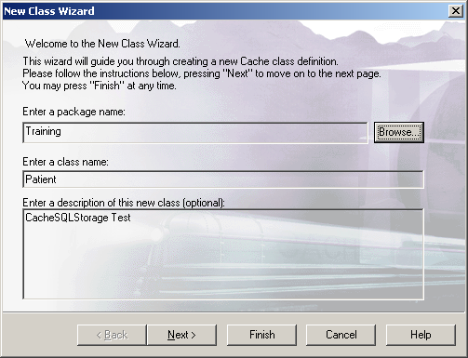
Create a Persistent Class

Slide 35
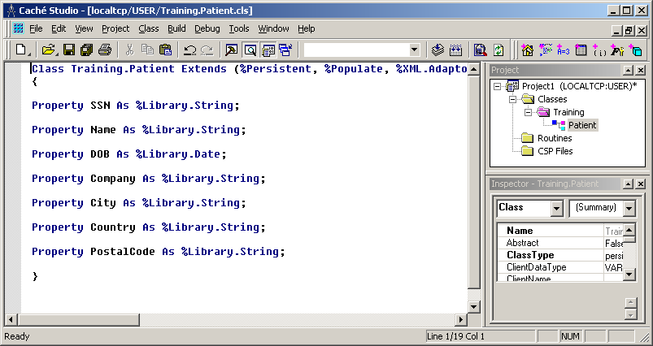
Add Properties

Slide 36
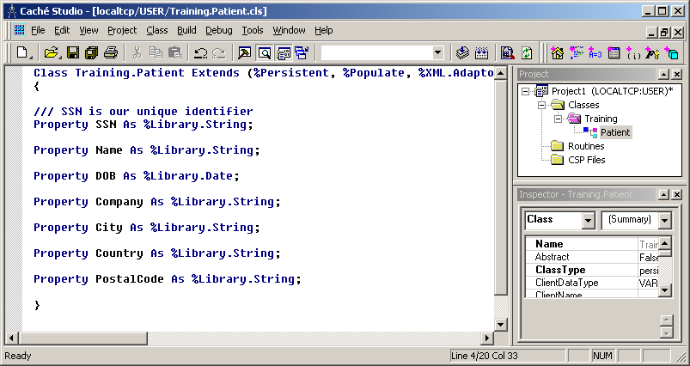
Choose a Unique Identifier
Our identifier will be based on 1 field: SSN

Slide 37
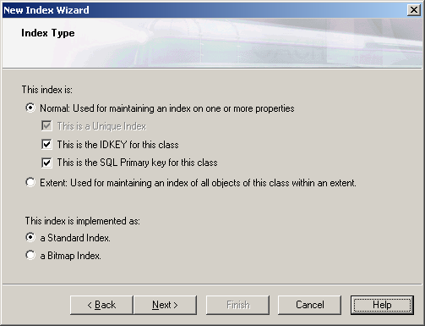
Declare an ID / Primary Key Index
Base this index on the SSN property
Don’t modify the index collation

Slide 38
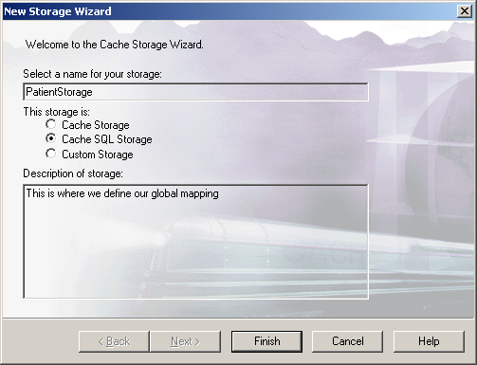
Create a Storage Definition

Slide 39
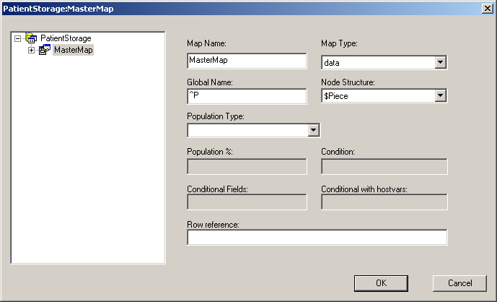
Create a Data Map
Map names cannot have spaces

Slide 40
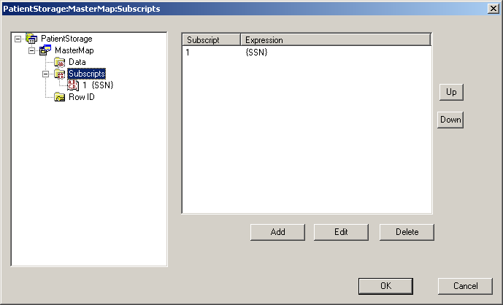
Define the Global Subscripts
Subscript level 1 is based on SSN

Slide 41
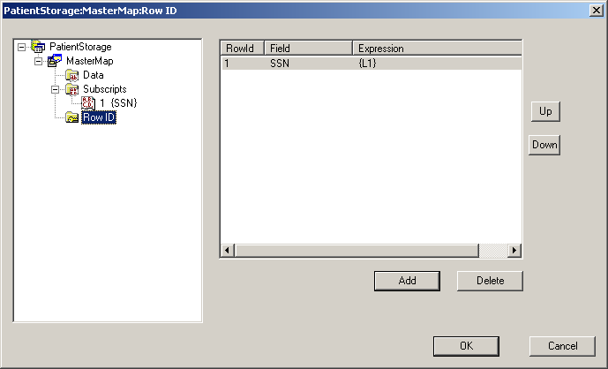
Define the Row ID
Row ID 1 is based on SSN in subscript level 1

Slide 42
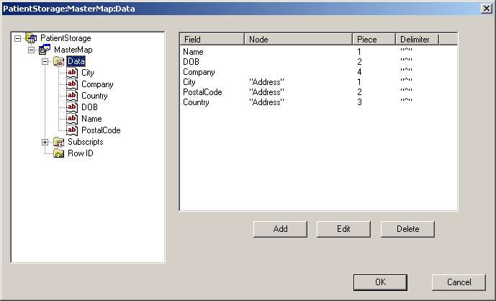
Define the Property Mappings
Enter delimiter and additional node information

Slide 43
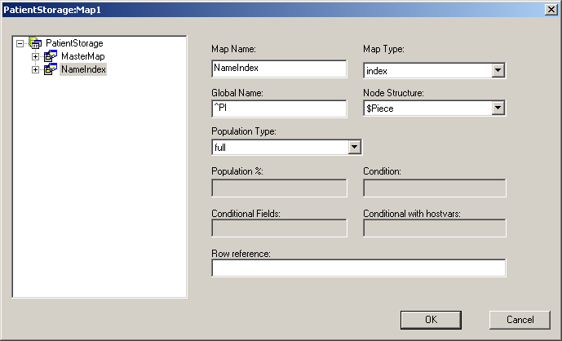
Create an Index Map
Choose a population type of ‘full’

Slide 44
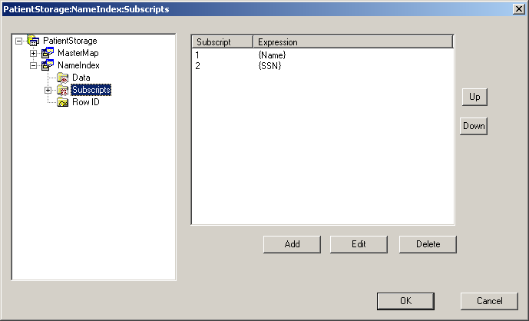
Define the Index Subscripts

Slide 45
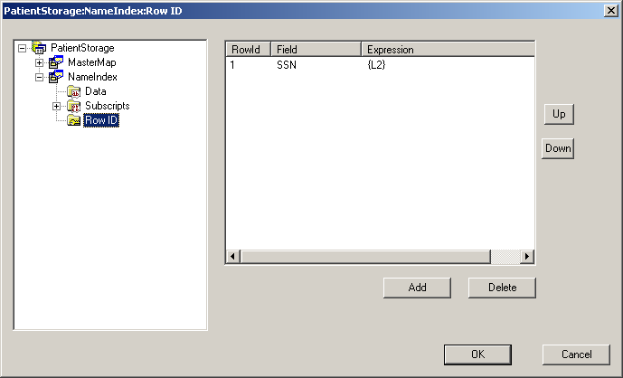
Define the Index Row ID
Row ID 1 is based on SSN in subscript level 2

Slide 46
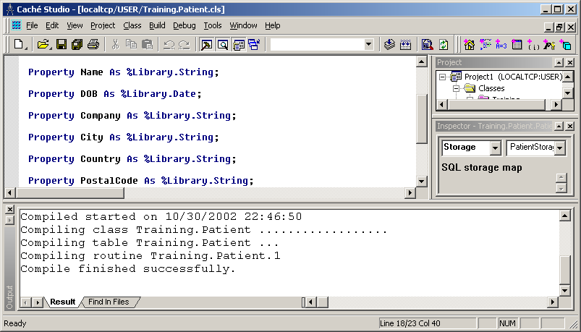
Save and Compile Class

Slide 47
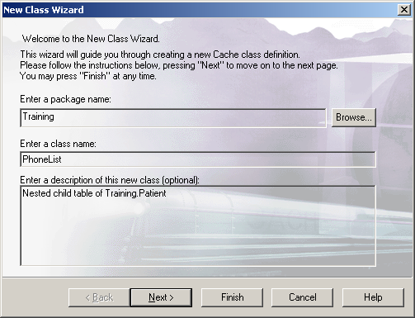
Create a PhoneList Child Table
This class will also be persistent

Slide 48
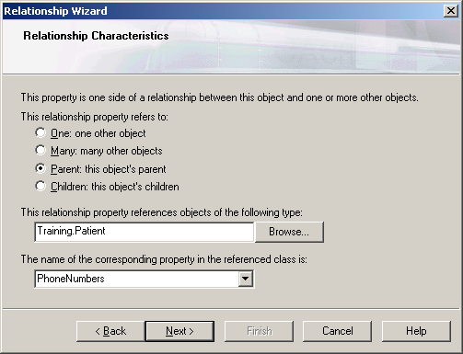
Create the Parent-Child Relationship
Relationships are special types of properties
In addition to naming the property in this class (PatientRef here), you must also specify the inverse side of the relationship (PhoneNumbers here)

Slide 49
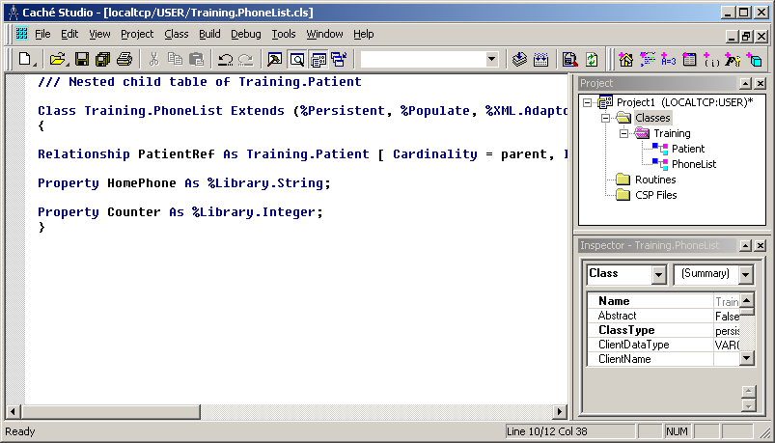
Add Additional Properties
In addition to defining a phone number, we must also define a property to represent the position within the embedded delimited string (Counter here)

Slide 50
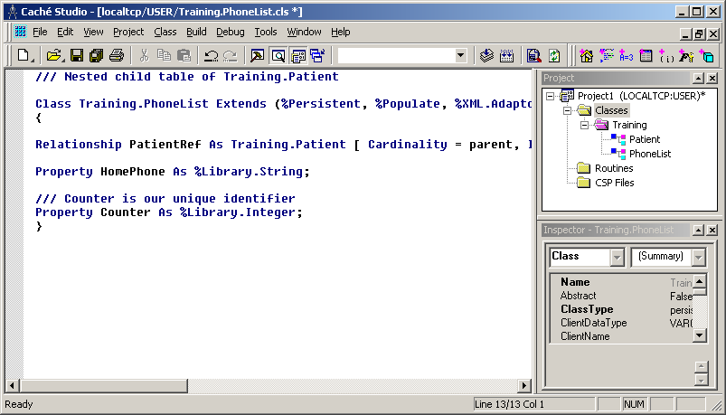
Choose a Unique Identifier
Our identifier will be based on 1 field: Counter

Slide 51
Declare an ID / Primary Key Index
Base this index on the Counter property
Don’t modify the index collation
The PatientRef property is implicitly part of the IDKey / Primary Key

Slide 52
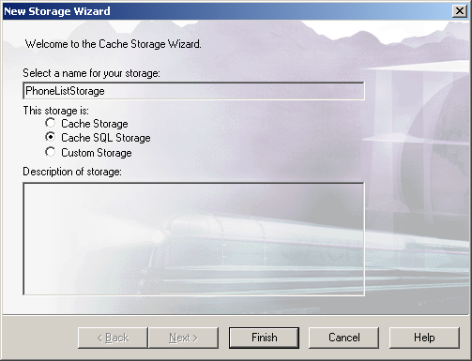
Create a Storage Definition

Slide 53
Create a Data Map
Map names cannot have spaces

Slide 54
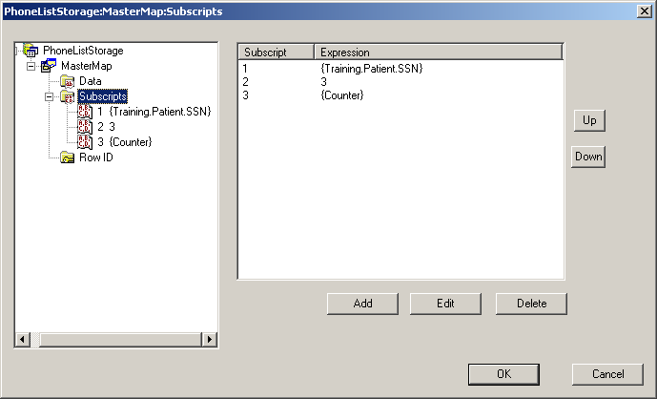
Define the Global Subscripts
Subscript level 1 is based on Training.Patient.SSN
Subscript level 2 is based on the “^” delimiter, using the 3rd position
Subscript level 3 is based on the “~” delimiter, using Counter for position

Slide 55
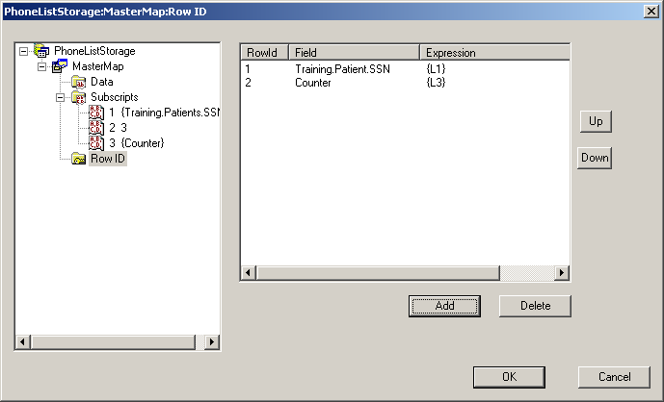
Define the Row ID
Row ID 1 is based on Training.Patient.SSN in subscript level 1
Row ID 2 is based on Counter in subscript level 3

Slide 56
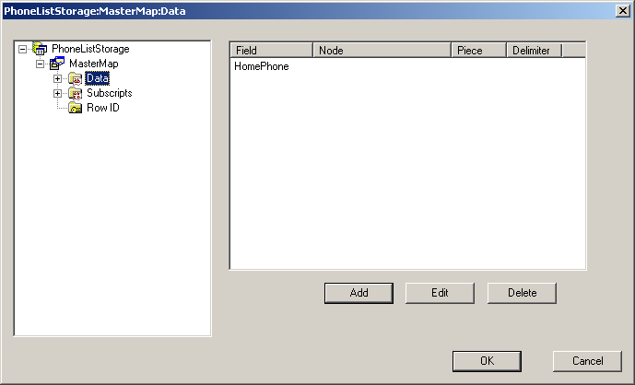
Define the Property Mappings
Here, you can enter HomePhone with no additional specifications

Slide 57
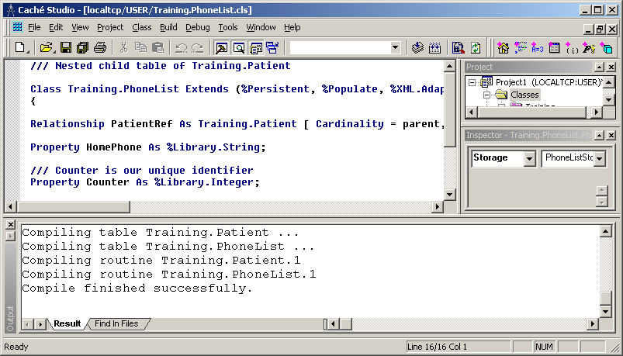
Save and Compile Class

Slide 58

Create a Visit Child Table
This class will also be persistent

Slide 59
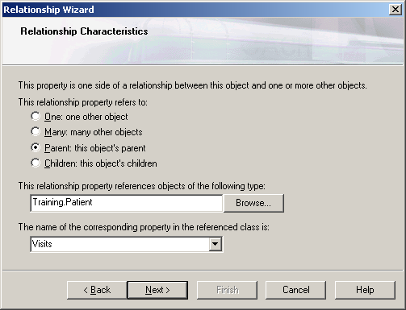
Create the Parent-Child Relationship
In addition to naming the property in this class (PatientRef here), you must also specify the inverse side of the relationship (Visits here)

Slide 60
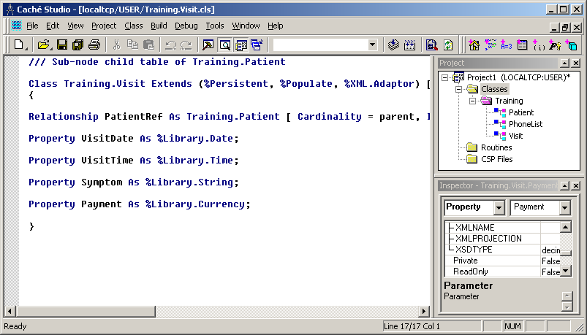
Add Additional Properties

Slide 61
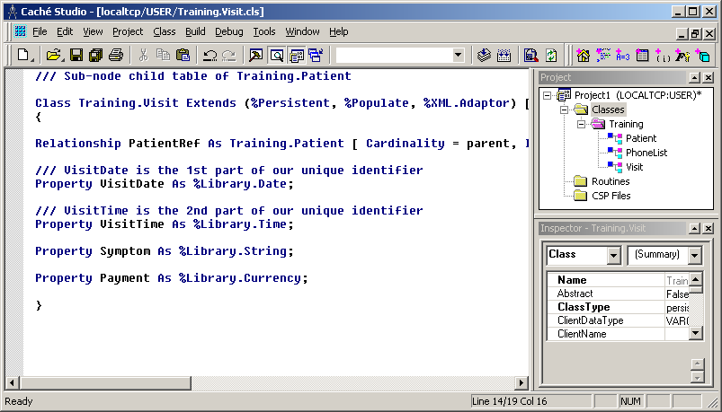
Choose a Unique Identifier
This time, our identifier will be based on 2 fields: VisitDate and VisitTime

Slide 62
Declare an ID / Primary Key Index
Base this index on the VisitDate and VisitTime properties
Don’t modify the index collation
The PatientRef property is implicitly part of the IDKey / Primary Key

Slide 63

Create a Storage Definition

Slide 64
Create a Data Map
Map names cannot have spaces

Slide 65
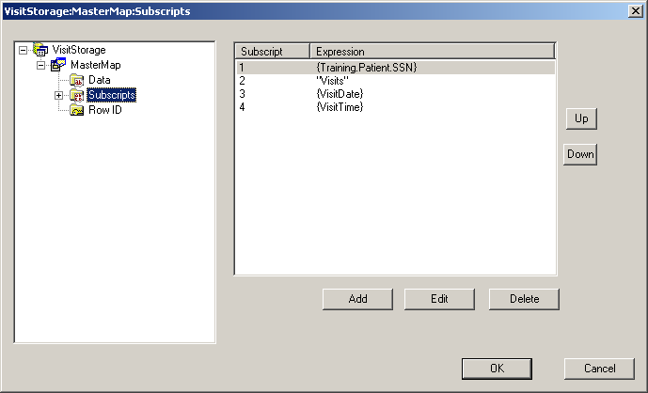
Define the Global Subscripts
Subscript level 1 is based on Training.Patient.SSN
Subscript level 2 is a string literal: “Visits”
Subscript level 3 is based on VisitDate
Subscript level 4 is based on VisitTime

Slide 66
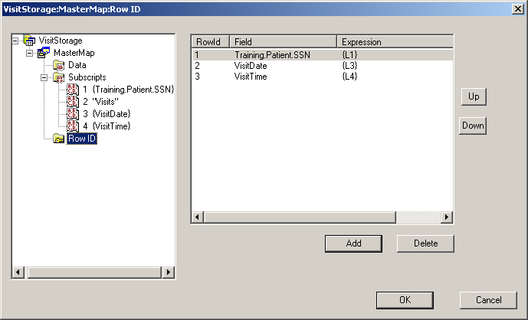
Define the Row ID
Row ID 1 is based on Training.Patient.SSN in subscript level 1
Row ID 2 is based on VisitDate in subscript level 3
Row ID 3 is based on VisitTime in subscript level 4

Slide 67
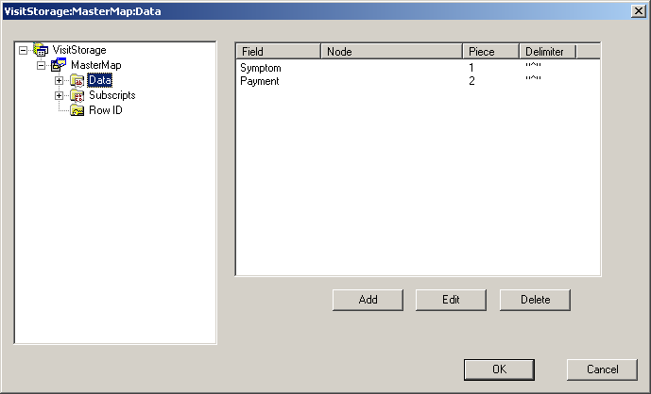
Define the Property Mappings

Slide 68
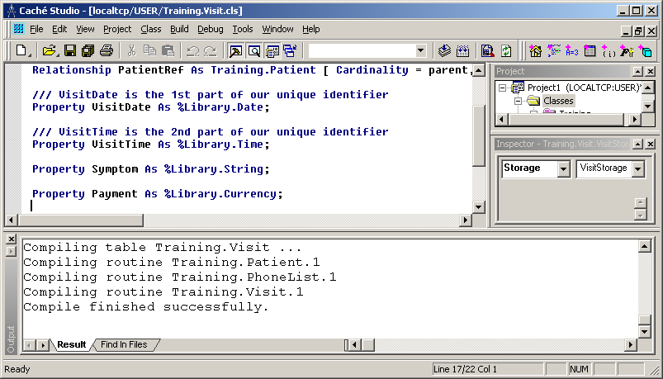
Save and Compile Class

Slide 69
Mapping Existing Globals to Objects and SQL
Mike LaRocca
InterSystems Corporation

